Slide 1
GRAMS: A Graph-based Approach for Inferring Semantic Descriptions of Wikipedia Tables
Binh Vu, Craig Knoblock, Pedro Szekely, Jay Pujara, Minh Pham
Information Sciences Institute
University of Southern California

Slide 2
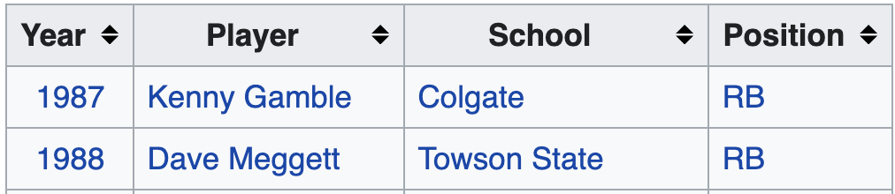
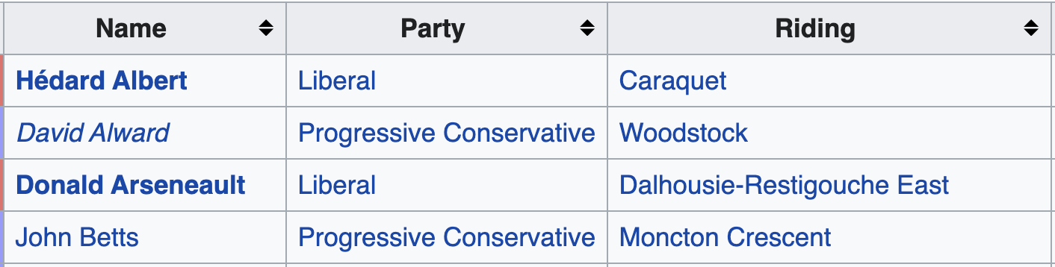
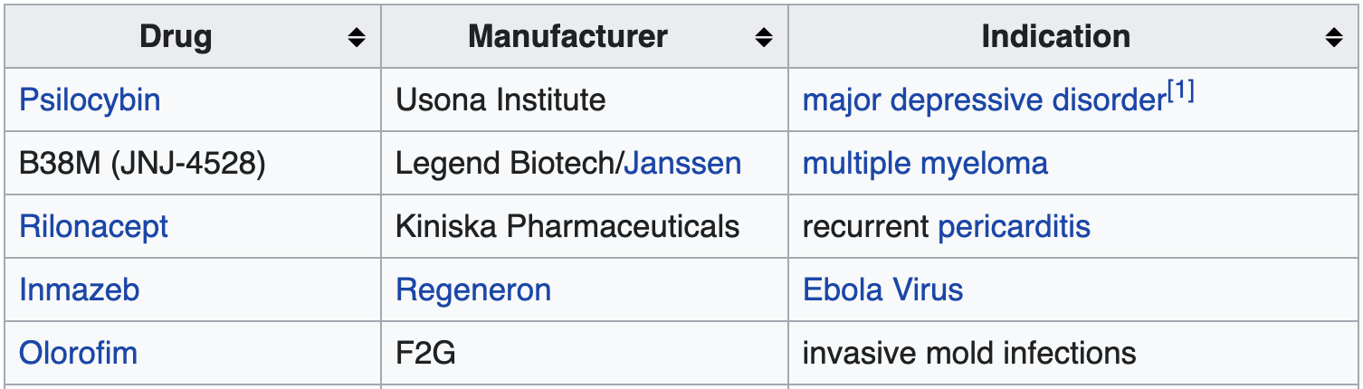
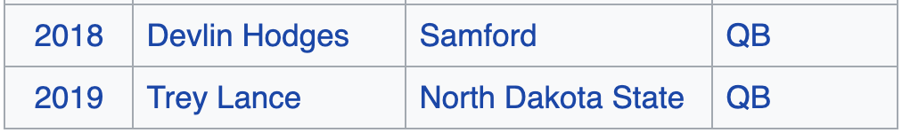
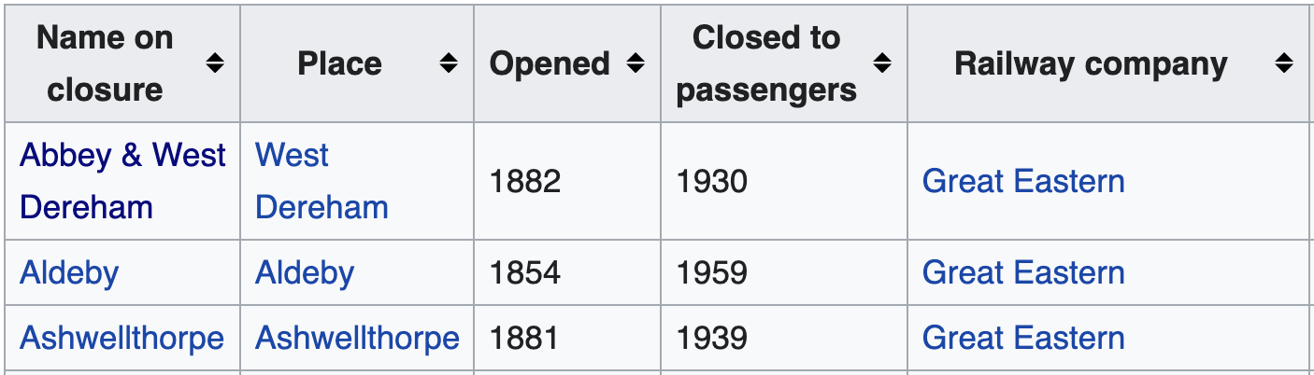
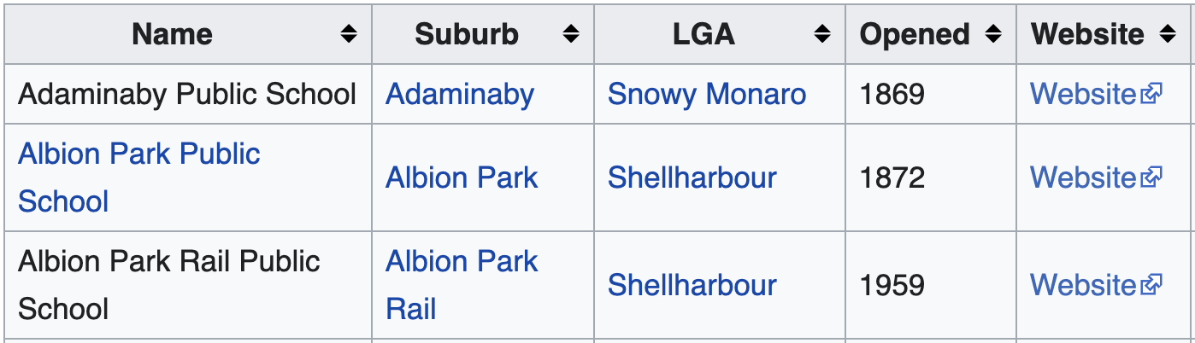
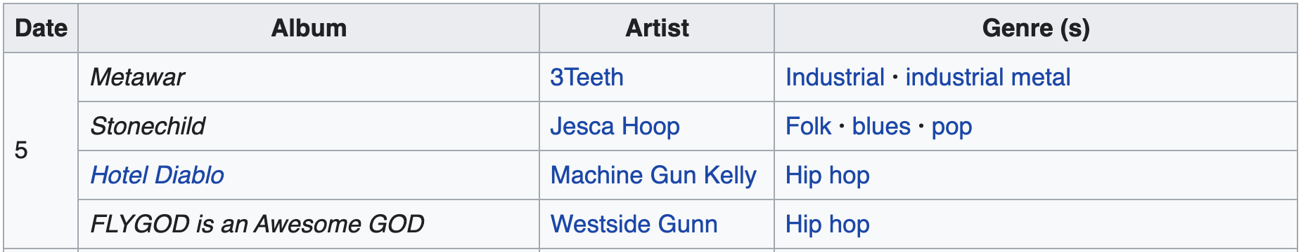
Motivating Example
Wikipedia has 7.5 millions tables covering many domains
List of players won Walter Payton Award
Members of 56th New Brunswick Legislature
List of drugs granted breakthrough therapy designation
List of historic railway stations
List of public schools in New South Wales
List of albums in 2019 (USA)

Slide 3
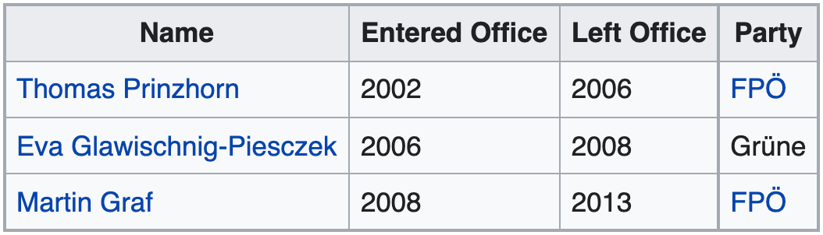
Source Modeling Problem
Building semantic descriptions of tables
Describing data source using classes and properties in ontologies
Human
political party (P102)
position held (P39)
rdfs:label
P39
Statement
Political Party
Third President
start time (P580)
end time (P582)
rdfs:label
Third Presidents of National Council (Austria)

Slide 4
Source Modeling Problem
Building semantic descriptions of tables
Describing data source using classes and properties in ontologies
statement’s property
statement’s qualifiers
Human
statement’s value
position held (P39)
P39
Statement
Third President
start time (P580)
end time (P582)
Third Presidents of National Council (Austria)

Slide 5
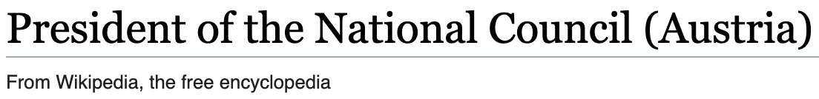
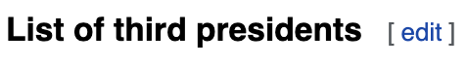
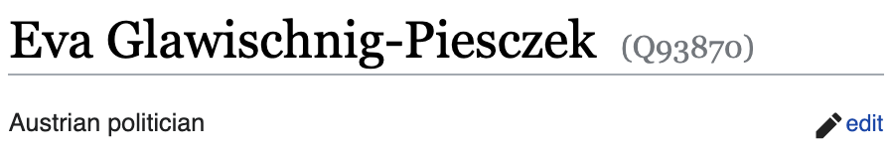
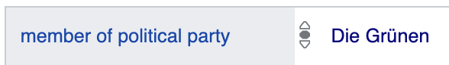
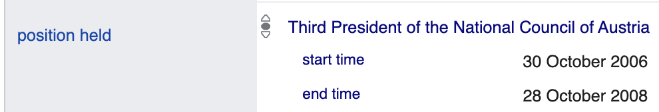
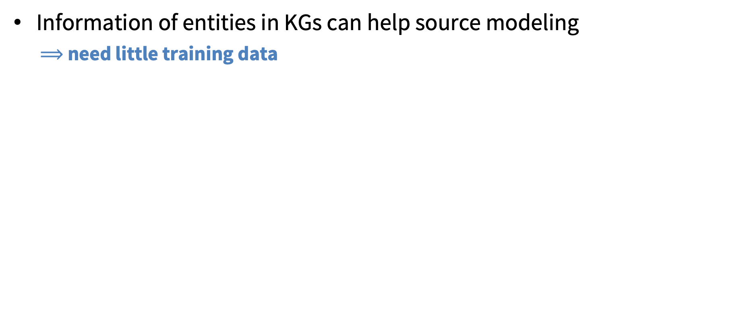
Main Idea
Information of entities in KGs can help source modeling
$⟹$ need little training data
Challenges:
n-ary relationships
contextual values

Slide 6

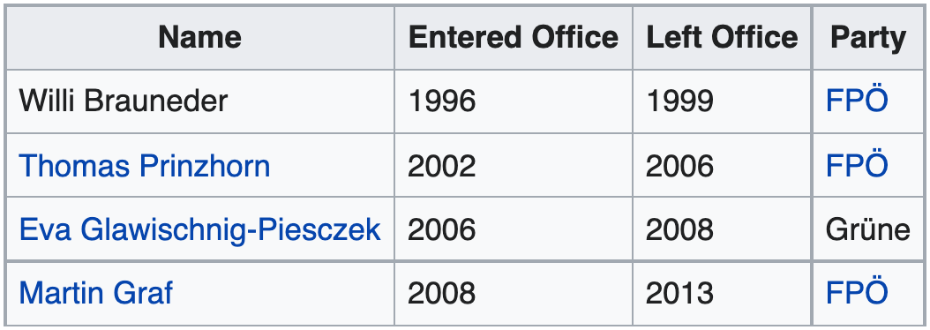
Approach
Linked table
{
}
Candidate Graph
Semantic Description
Contextual values

Slide 7
Construct Candidate Graph: Discovering Links
Create a graph of cells and context
Thomas
2002
2006
FPO
Eva
2006
2008
Grune
Martin
2008
2013
FPO
Third President
context

Slide 8
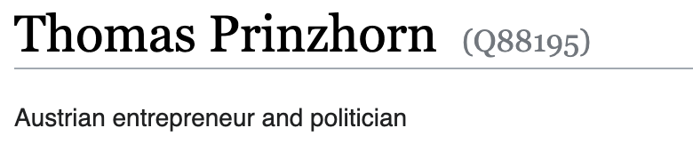
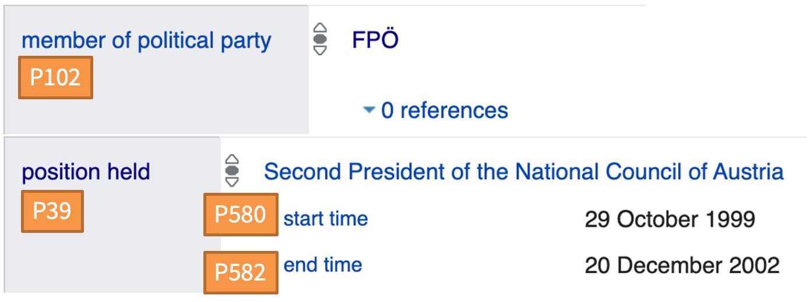
Construct Candidate Graph: Discovering Links
Add links discovered from knowledge in Wikidata
P39
Second President
entity in WD
P39
P582
Thomas
Thomas
2002
2006
FPO
P102
WD Statement
P39
P580
P582
Eva
Eva
P39
2006
2008
Grune
P39
P580
Martin
2008
2013
FPO
P39
Third President
P39 : position held
P580: start time
P582: end time
fuzzy match
P102

Slide 9
Construct Candidate Graph: Summarization
Group links of cells from same source & target columns/context
P39
Second President
P39
P582
Thomas
2002
2006
FPO
P102
P39
P580
P582
Eva
P39
2006
2008
Grune
P39
P580
Martin
2008
2013
FPO
P39
Third President
P39 : position held
P580: start time
P582: end time
P102

Slide 10
Construct Candidate Graph: Summarization
P39
Second President
P39
P582
Thomas
2002
2006
FPO
P39
P580
P582
Eva
2006
2008
Grune
P39
P39
P580
Martin
2008
2013
FPO
P39
Name
Third President
Party
P102
P39 : position held
P580: start time
P582: end time

Slide 11
Construct Candidate Graph: Summarization
P39
Second President
P39
P582
Thomas
2002
2006
FPO
Eva
2006
2008
Grune
Martin
2008
2013
FPO
Name
Entered Office
Left Office
Party
P102
P39
P580
P582
P39 : position held
P580: start time
P582: end time
Third President
P39

Slide 12
Construct Candidate Graph: Summarization
P39
Second President
P39
P582
Thomas
2002
2006
FPO
Eva
2006
2008
Grune
Martin
2008
2013
FPO
Name
Entered Office
Left Office
Party
P102
P39
P580
P582
P39 : position held
P580: start time
P582: end time
Third President
P39

Slide 13
Construct Candidate Graph: Summarization
P39
Second President
P582
P39
Thomas
2002
2006
FPO
Eva
2006
2008
Grune
Martin
2008
2013
FPO
Name
Entered Office
Left Office
Party
P102
P39
P580
P582
P39 : position held
P580: start time
P582: end time
Third President
P39

Slide 14
Construct Candidate Graph: Summarization
Final candidate graph
P39
Second President
P39
P582
Name
Entered Office
Left Office
Party
P102
P39
P580
P582
P39 : position held
P580: start time
P582: end time
Third President
P39

Slide 15
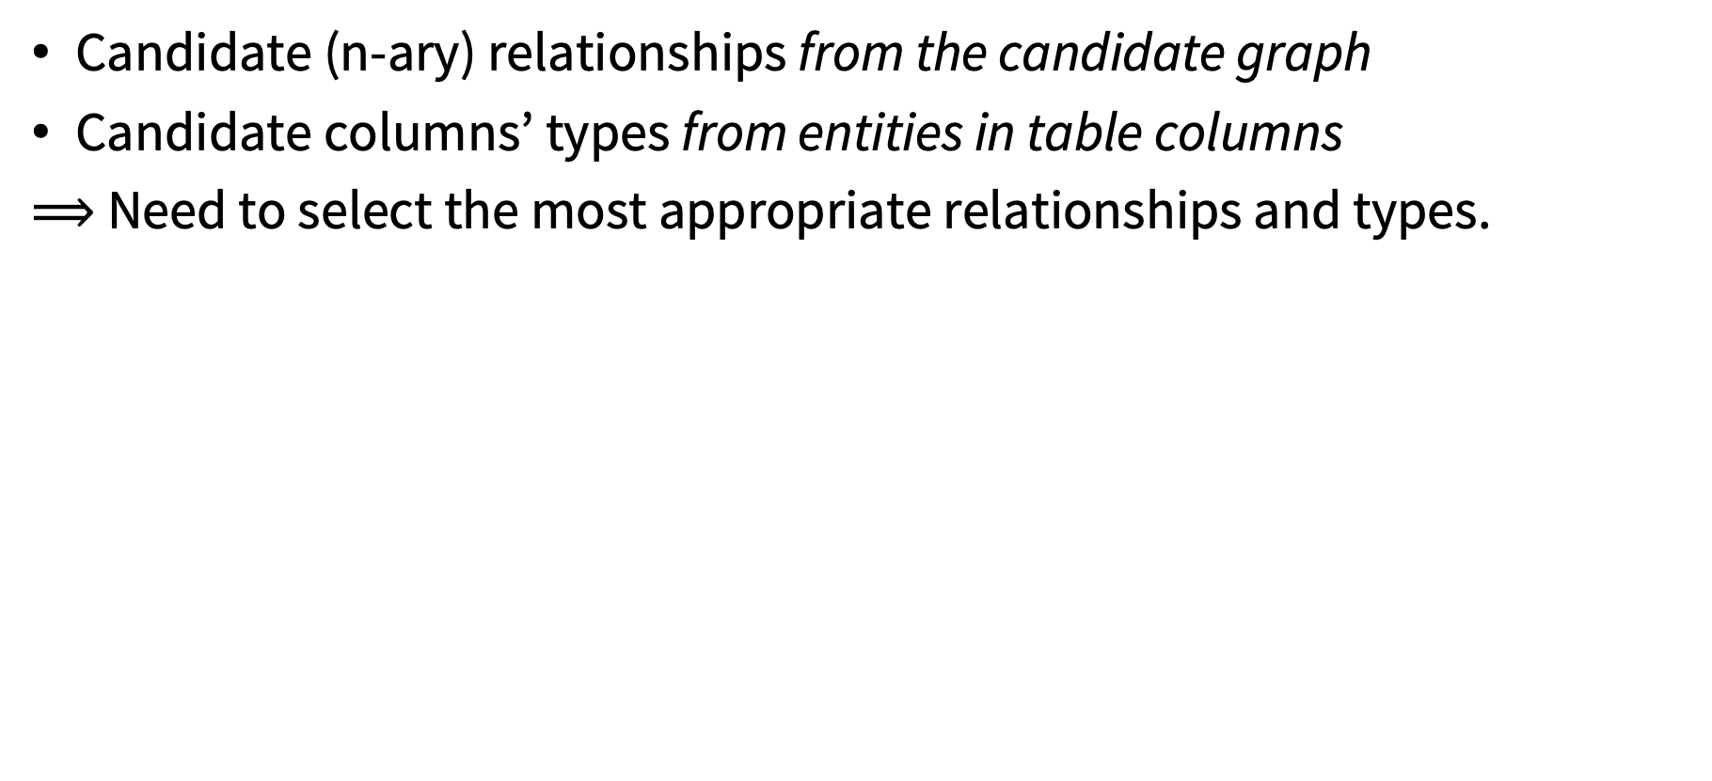
After Building Candidate Graph
Candidate (n-ary) relationships from the candidate graph
Candidate columns’ types from entities in table columns
$⟹$ Need to select the most appropriate relationships and types.
Human (Q5)
Human (Q5)
P39
P39
Second President
P39
Second President
P39
P582
P582
Name
Name
P39
P39
P102
P102
Political Party (Q7278)
P39
Political Party (Q7278)
P39
P582
P580
P582
P580
Third President
Third President
Organization (Q43229)
Organization (Q43229)
Entered
Office
Entered
Office
Left
Office
Left
Office
Party
Party
Semantic Description
Candidate Graph

Slide 16
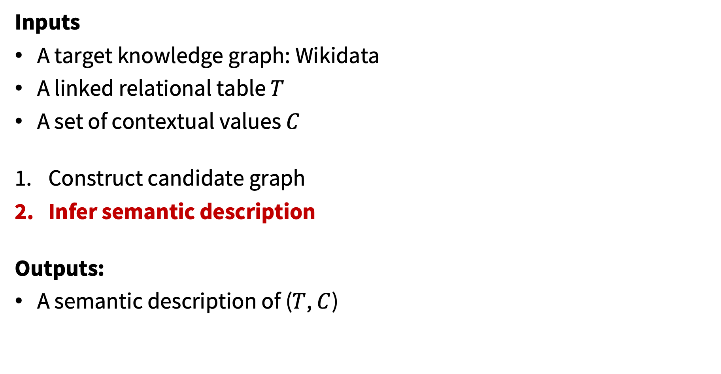
Approach
Inputs
A target knowledge graph: Wikidata
A linked relational table $T$
A set of contextual values $C$
Construct candidate graph
Infer semantic description
Outputs:
A semantic description of ($T$, $C$)

Slide 17
Collective Reasoning Problem
Probabilistic Soft Logic (PSL)
“A probabilistic graphical models framework using first-order logic”
Two main elements: predicates and rules
Predicates have “soft” value in [0, 1]
Rules converted to exponential function to approximate P(x)

Slide 18
PSL Predicates (examples)
Name
CorrectRel(N₁, N₂, P): if a relationship is correct
CorrectRel(Name, stmt₁, P39)
CorrectRel(stmt₁, Entered Office, P580)
CorrectRel(stmt₁, Third President, P39)
CorrectType(N₁, T): if a column type assignment is correct
CorrectType(Party, Organization)
CorrectType(Party, Political Party)
CorrectType(Name, Human)
… and more
P39
stmt₁
P39
P580
Third President
Entered
Office
Human (Q5)
Name
member of political party (P102)
Political Party (Q7278)
Party
Organization (Q43229)
P39: position held P580: start time P582: end time

Slide 19
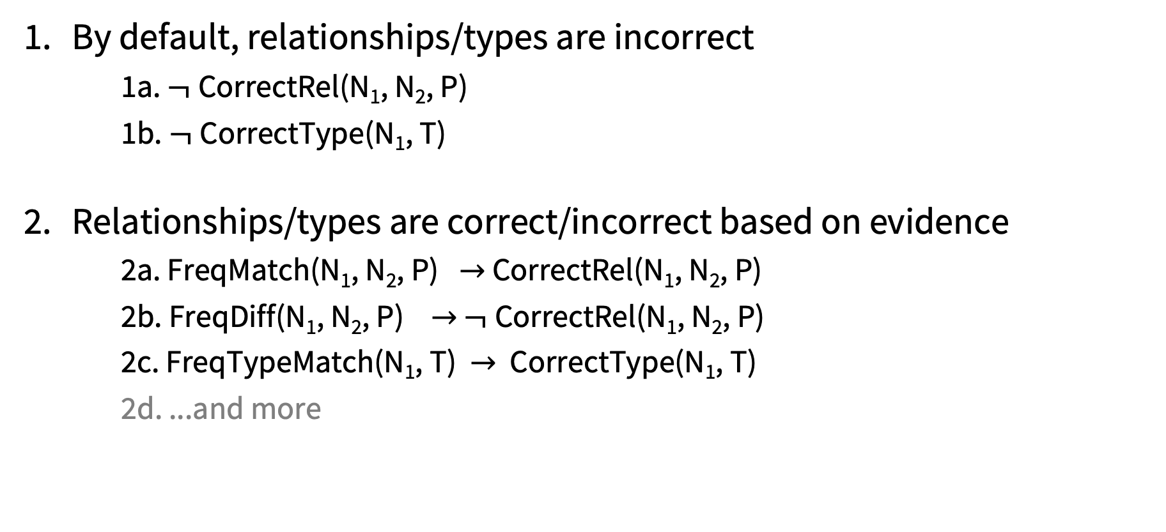
PSL Rules (examples)
By default, relationships/types are incorrect
1a. $¬$CorrectRel(N₁, N₂, P)
1b. $¬$CorrectType(N₁, T)
Relationships/types are correct/incorrect based on evidence
2a. FreqMatch(N₁, N₂, P) $→$ CorrectRel(N₁, N₂, P)
2b. FreqDiff(N₁, N₂, P) $→$ $¬$CorrectRel(N₁, N₂, P)
2c. FreqTypeMatch(N₁, T) $→$ CorrectType(N₁, T)
2d. ...and more

Slide 20
PSL Rules (examples)
If a statement value is incorrect, then the statement’s qualifiers are also incorrect
We prefer fine-grain properties than high-level properties
…and more
P39
Second President
P39
Second President
P39
P39
Name
P582
Name
P582
Entered Office
Entered Office
location (P276)
is parent of
located in admin.
area (P131)
P276
P276
P276
P276
City
State
City
State
P131
P131
P131
P131

Slide 21
Post-Processing
PSL outputs probability of each relationships and types.
Use BANK algorithm to choose the most probable relationships
Avoid unnecessary loops
Prefer tree structure if possible
place served (P931): 0.91
Airport
City
located in (P131) p=0.89
City
located (P131)
City
located (P131)
State
State
contains (P150)
P131
P131
BEFORE
Country
AFTER
Country

Slide 22
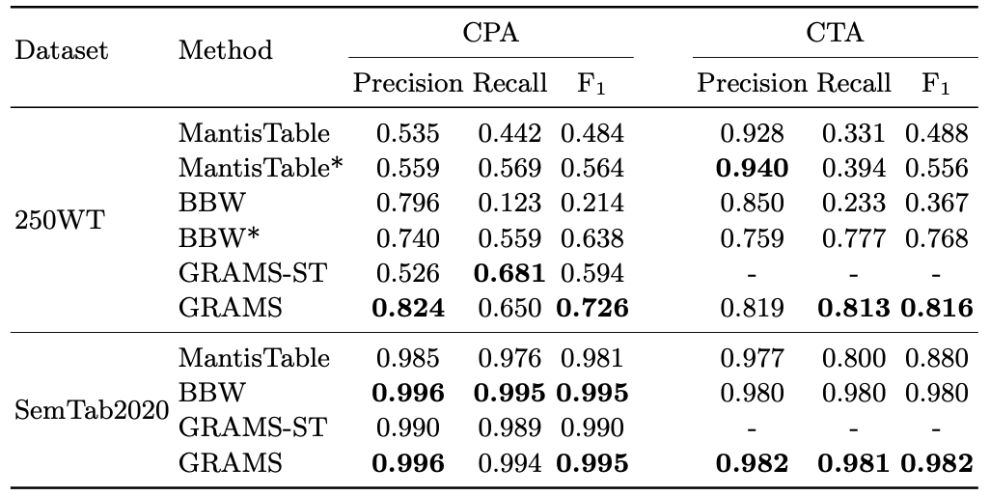
Evaluation of GRAMS
Collective reasoning is beneficial
Avoid cascading errors from subject column detection phase
Handle complex schema: multiple entities’ types and n-ary relationships
Wikipedia Tables
Synthetic Tables
MantisTable* and BBW* are modified to retrieve correct subject column

Slide 23
Related Work
 | Method | Method | Data Hungry | Modeling Capabilities
 |  |  |  | Handle Literal Columns | Handle Qualifiers | Denormalized Tables
Custom Ontologies | Taheriyan et al. 2016 | Taheriyan et al 2016 | Y | Y | Y | Y
 | Vu et al. 2019 | Vu et al 2019 | Y | Y | Y | Y
KG Ontologies | Iterative Method | Ritze et al. 2015 | - | Y | N | N
 |  | Zhang et al. 2017 | - | Y | N | N
 |  | SemTab systems | - | Y | N | N
 | Graphical Models | Limaye et al. 2010 | - | N | N | Y
 |  | Mulward et al. 2013 | - | N | N | Y
 |  | GRAMS | - | Y | Y | Y

Slide 24
Discussion and Future work
Contribution: A novel graph-based approach, GRAMS, for building semantic descriptions of Wikipedia Tables.
The candidate graph makes it easy to represent and discover n-ary relationships.
Using PSL to collectively infer correct relationships and types.
Future work:
Handle unlinked tables
Generate large labeled dataset from Wikipedia tables to train semantic modeling systems

